Slide 1
Operational Aspects

Slide 2
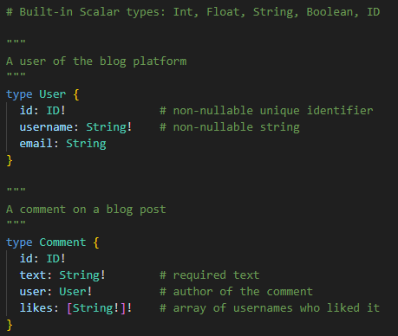
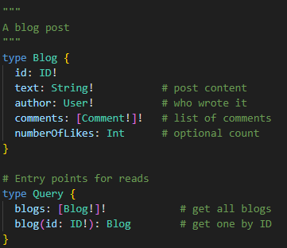
GraphQL Schema & Usage
Scalar types
Type definitions

Slide 3
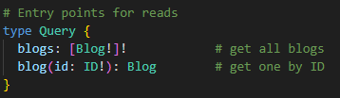
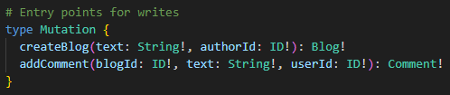
GraphQL Schema & Usage
Query
Mutation

Slide 4
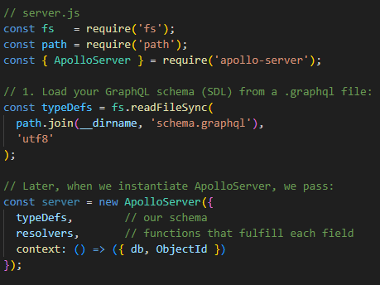
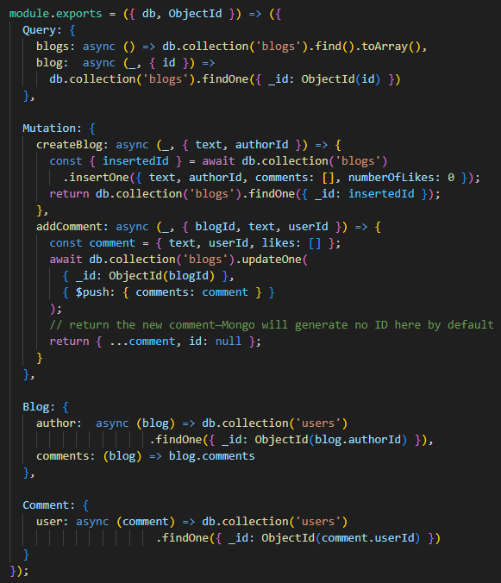
Using GraphQL in Apollo Serve
MongoDB/GraphQL
server.js
resolvers.js

Slide 5
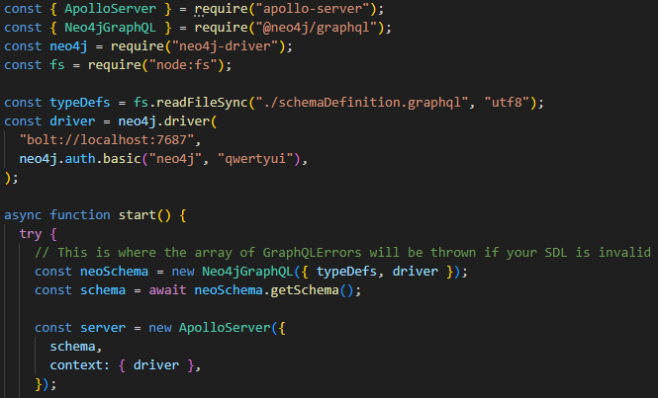
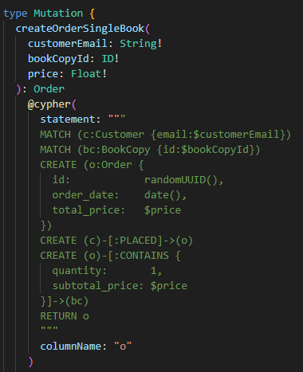
Using GraphQL in Apollo Serve
Neo4j/GraphQL
index.js

Slide 6
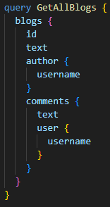
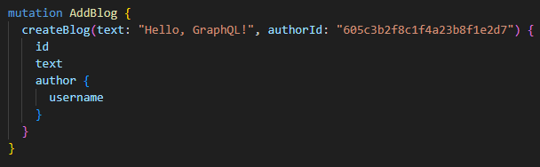
Using GraphQL in Apollo Serve
Sample Query
Sample Mutation

Slide 7
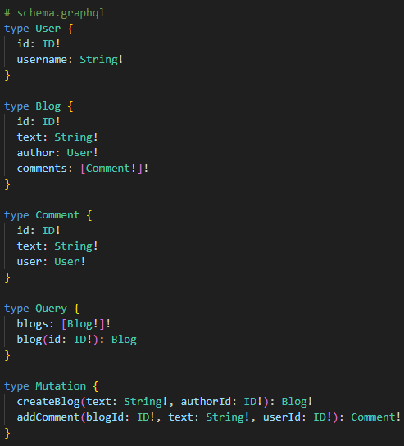
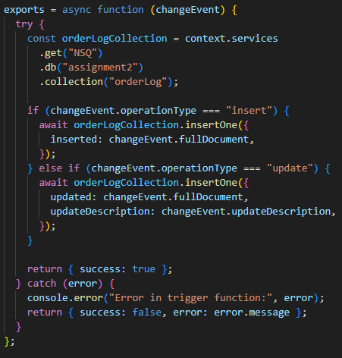

Comparing the GraphQL Schemas of Assignment 2 & 3
MongoDB + Apollo
Triggers

Slide 8
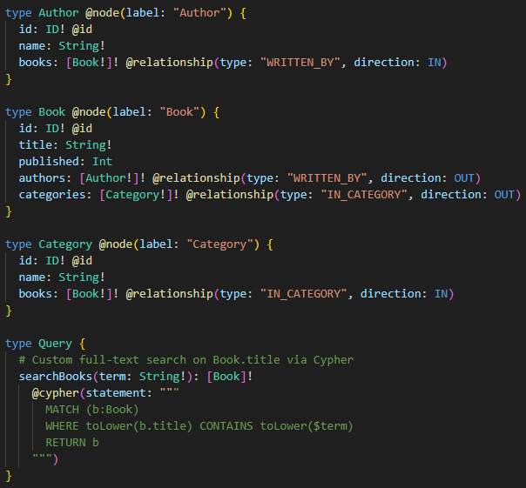
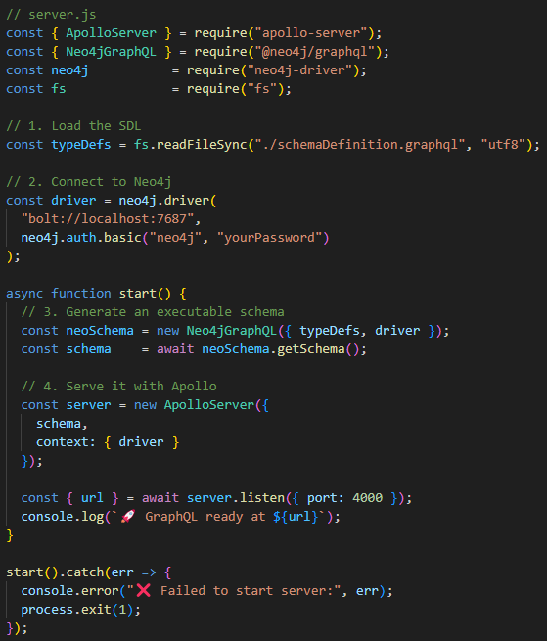
Comparing the GraphQL Schemas of Assignment 2 & 3
Schema definition
Apollo + Neo4jGraphQL

Slide 9
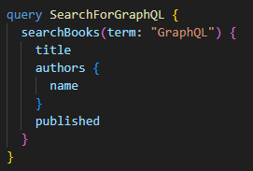
Comparing the GraphQL Schemas of Assignment 2 & 3
Sample Query

